Slide 1
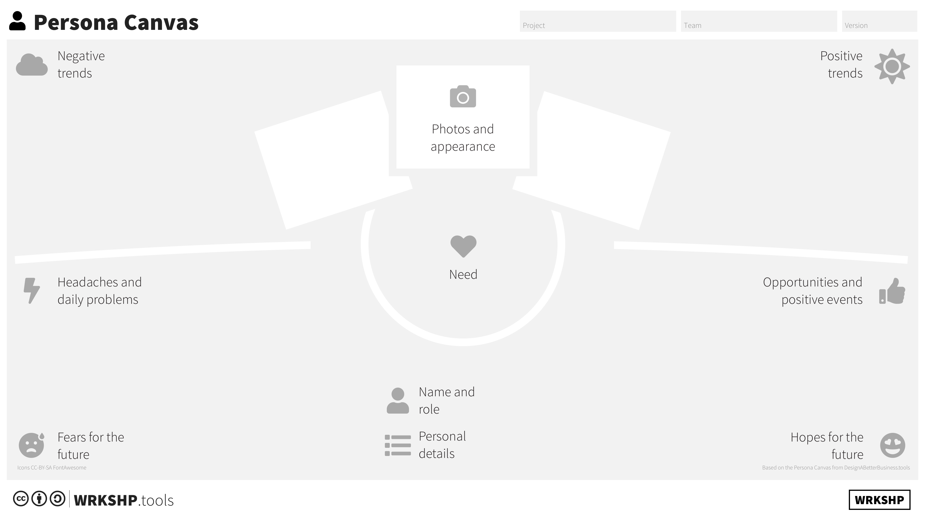
Post it!
Post it!
Post it!

